Slide 1
Ms. Dawson
Pepper Drive School

Slide 2
Thank you for supporting your student!
Thank you for taking the time to review this quick orientation! I am excited to provide an overview of the curriculum. I am truly honored to be your child’s teacher!

Slide 3
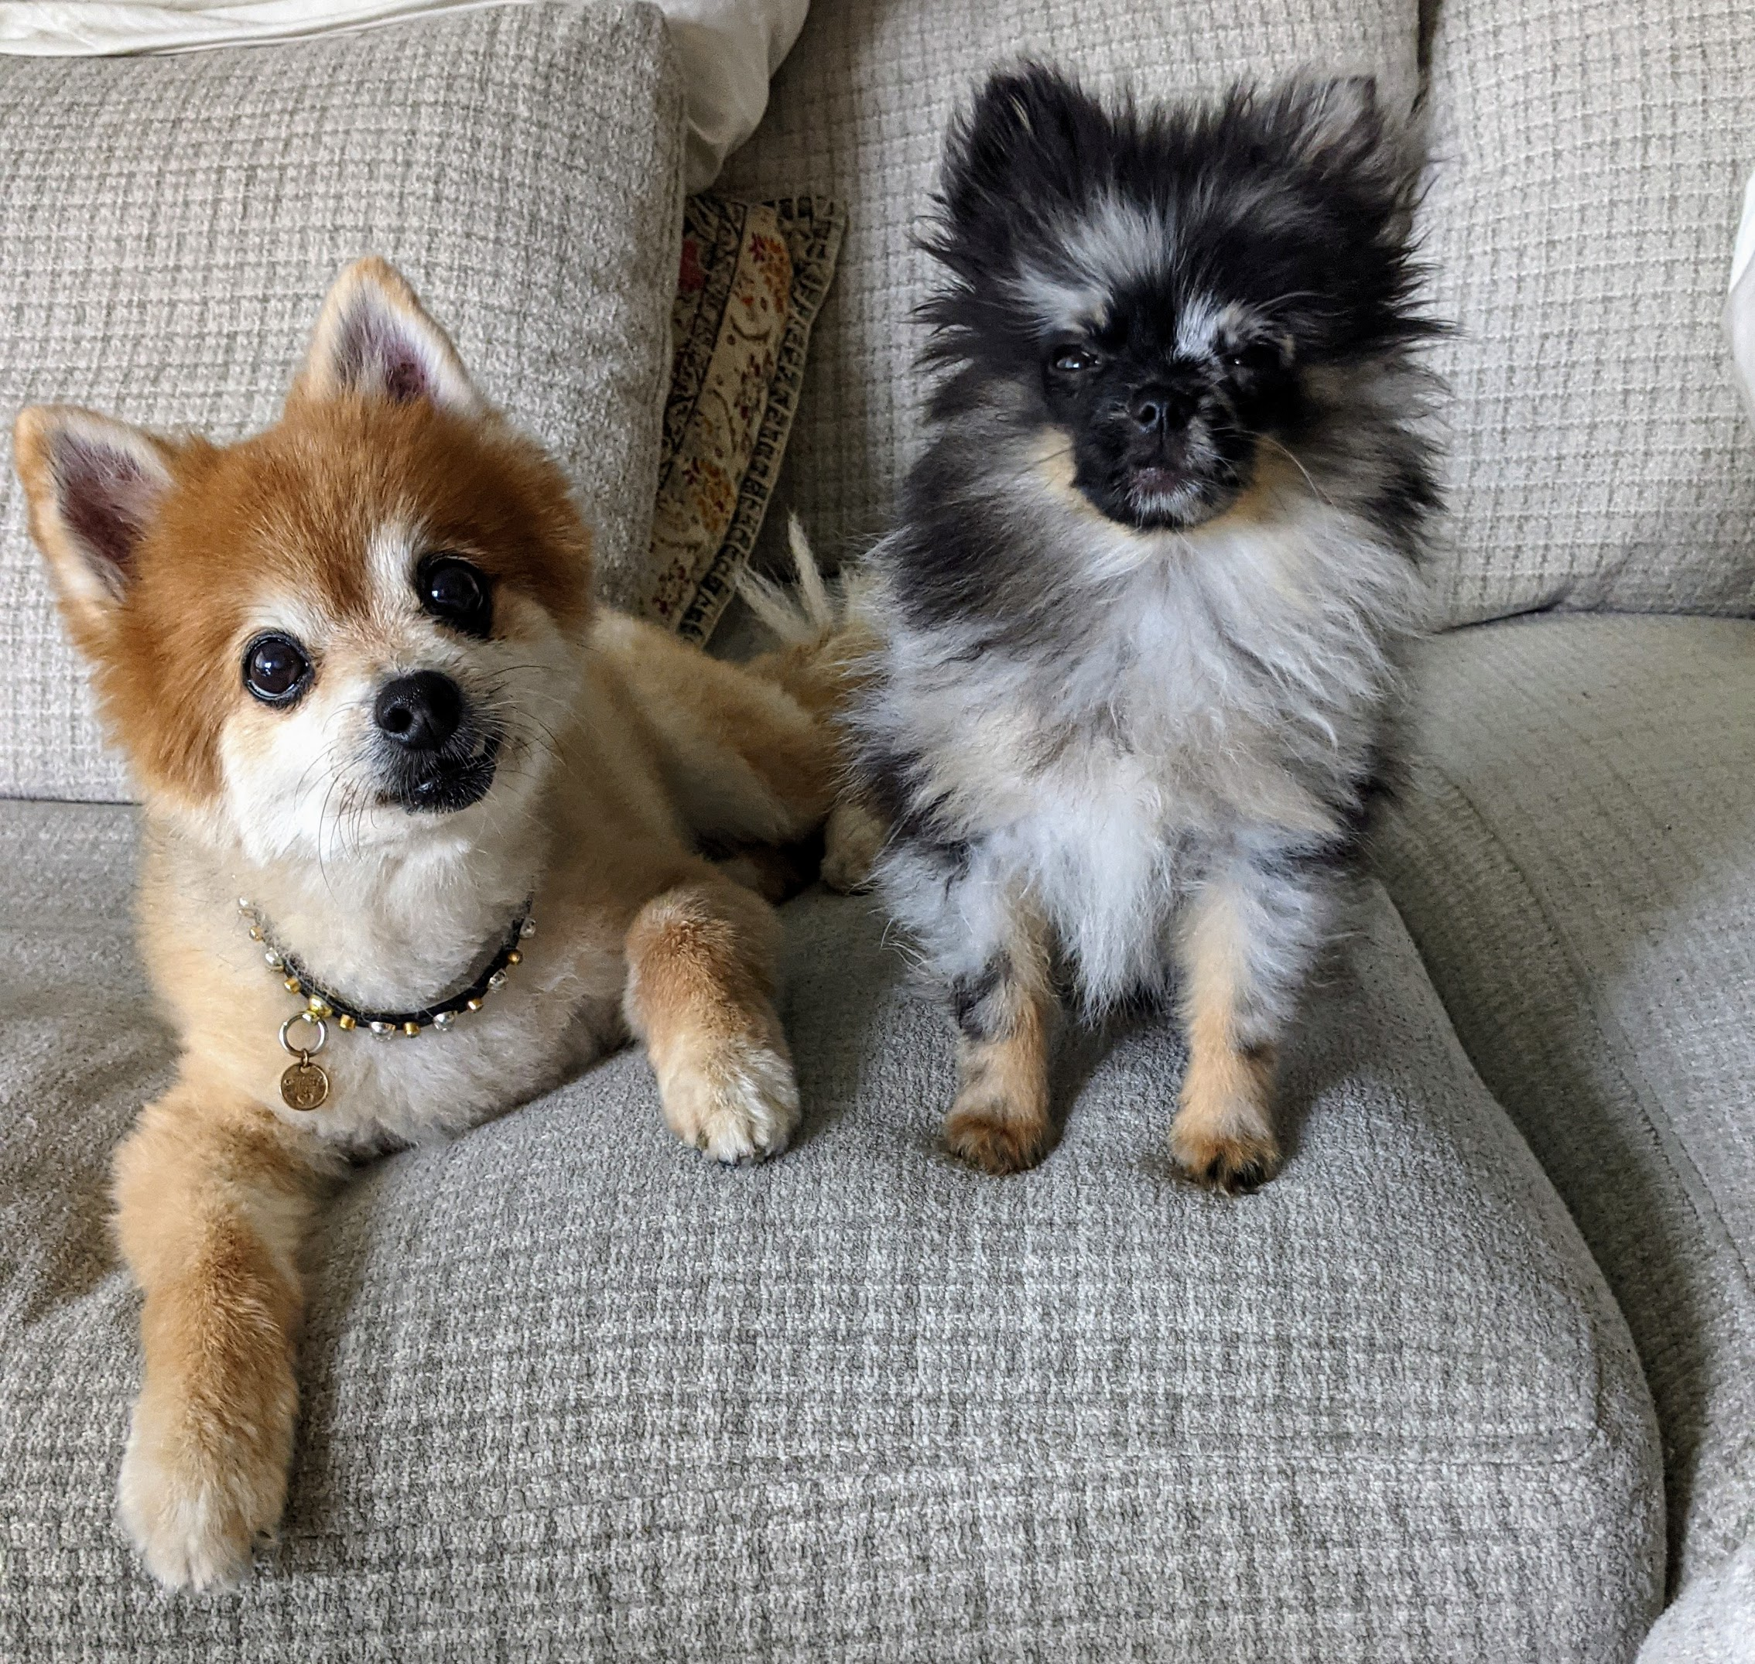
A Little About Me
I have been involved in education in one way another for over 15 years. I live downtown with my Pomeranian Larry. I grew up in East County and my family has been in San Diego since 1887!
I love to do yoga, go on urban hikes, and spend time with my huge family. I also enjoy traveling very much and taking rides at the beach on my cruiser. My favorite food is cheese. I really like cheese (and chai lattes :0)
I hold degrees in Cross Cultural Studies, Human Development and a Masters in Special Education. I earned my teaching credential from the University of San Diego.
I love learning and teaching. I believe in the infinite potential of every child. I believe in your child. That is why I am here!

Slide 4
Curriculum
Lucy Calkins Writing Program
Math Expressions
Pearson Social Science
Mystery/Amplify Science
Wonders/UFLI ELA
Engineering
Music
Physical Education
Second Step (Social Emotional Learning)

Slide 5
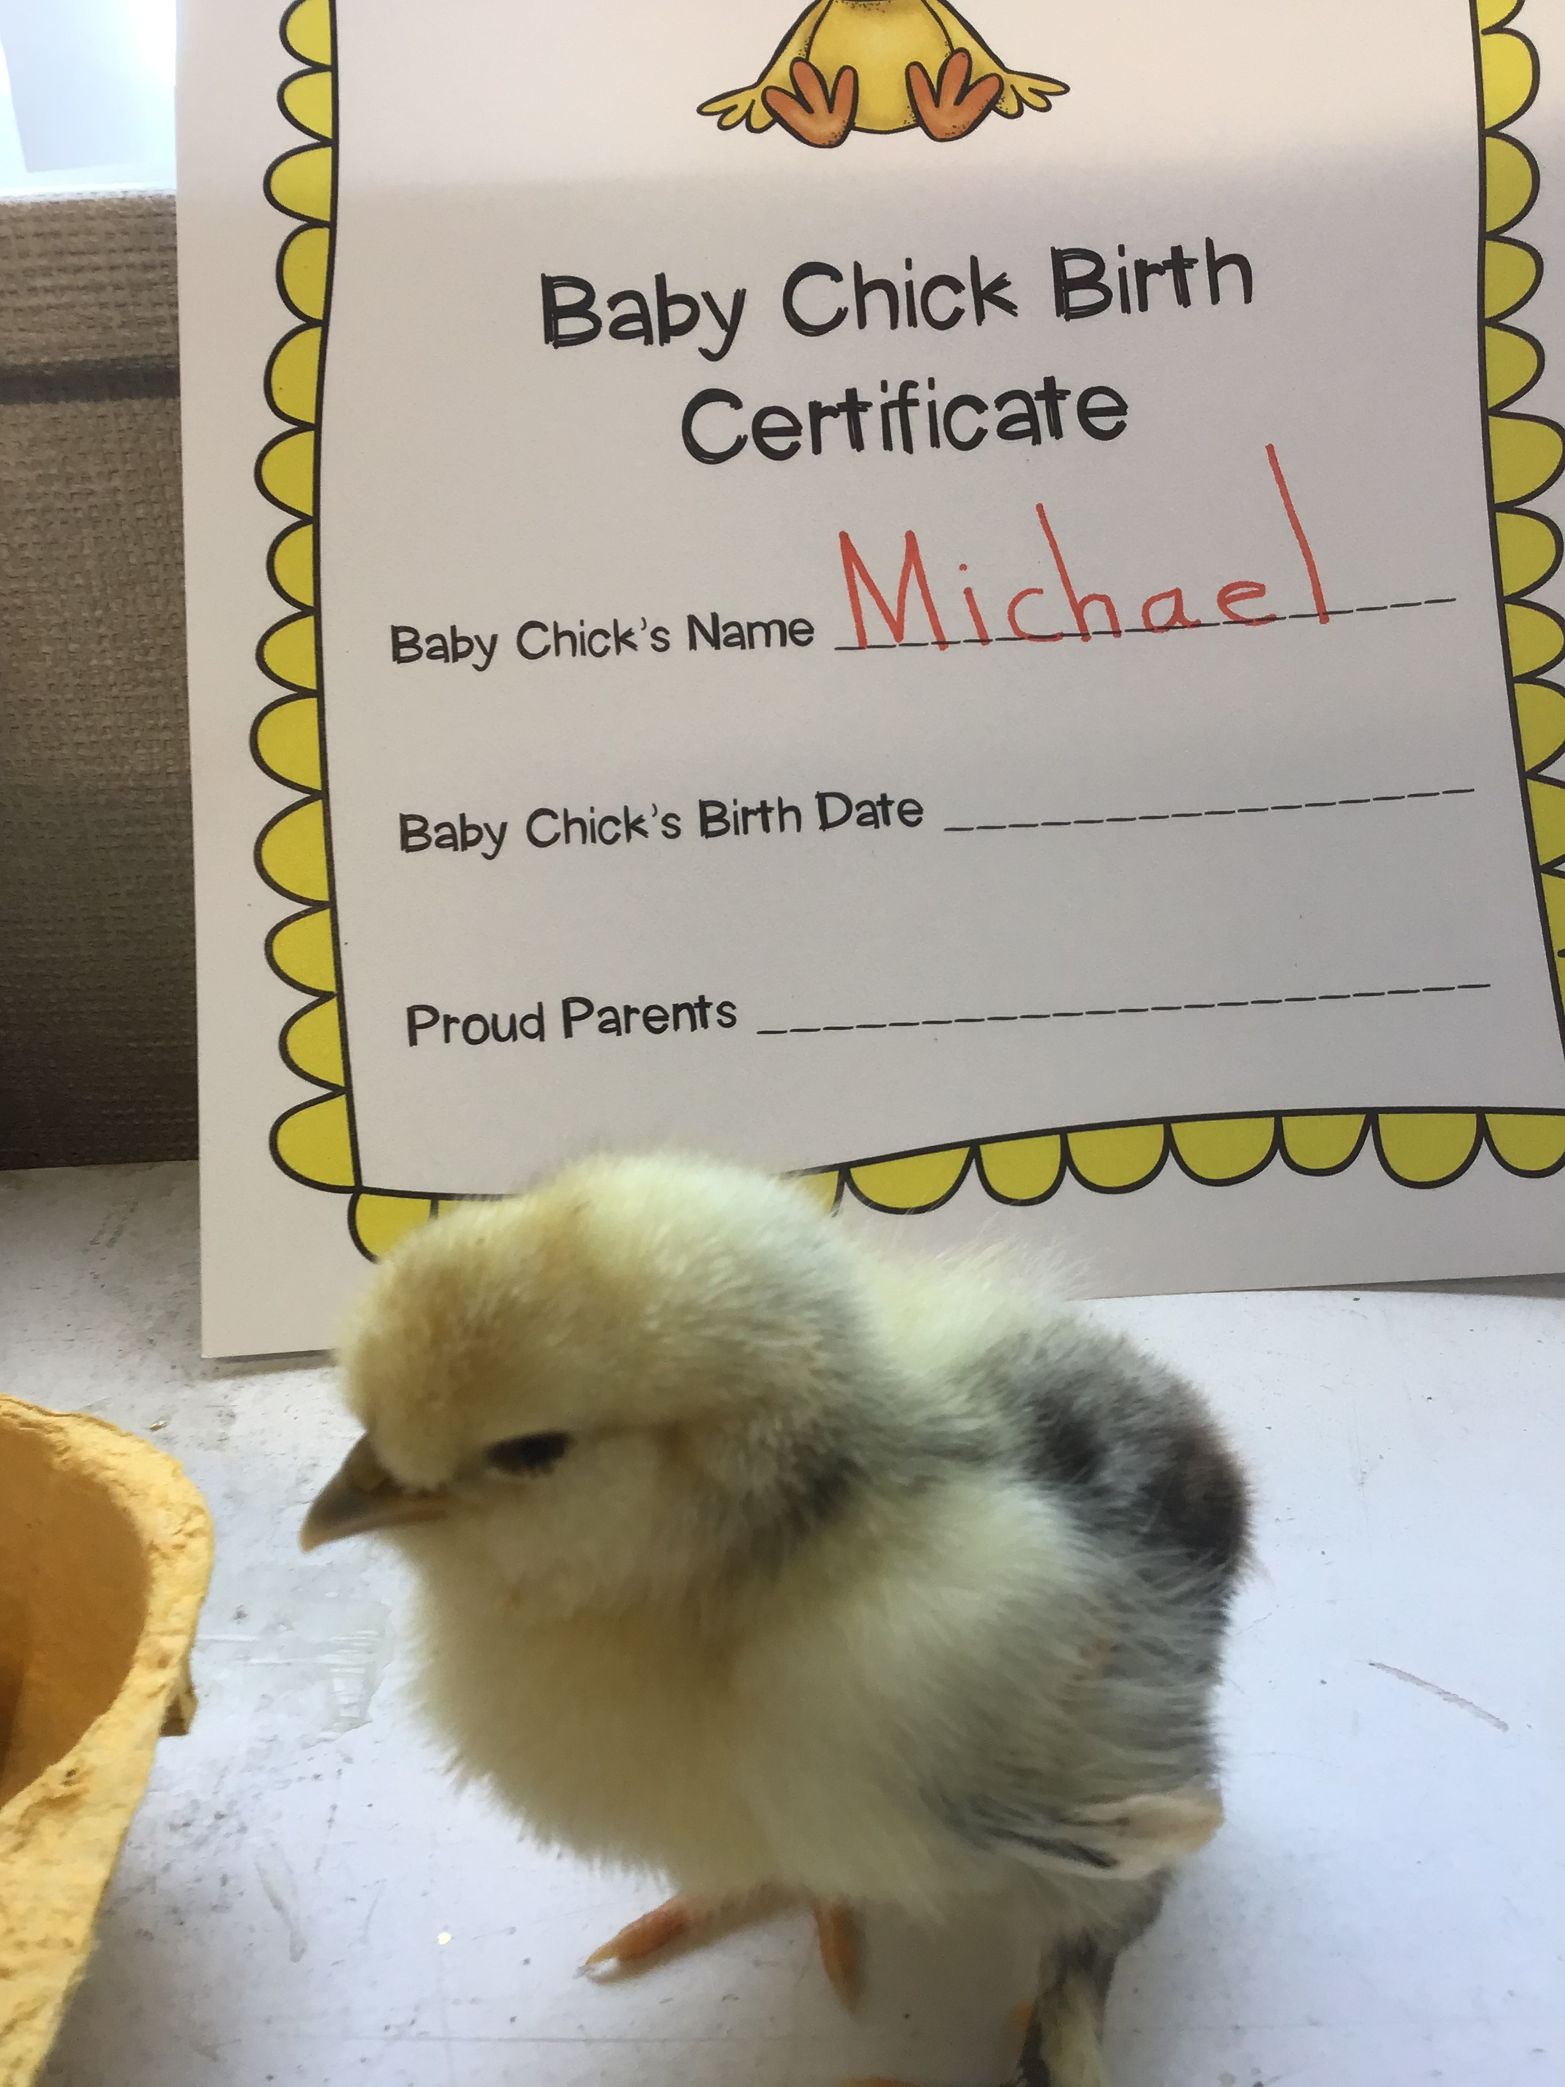
How You Can Help Your Student Be Successful?
Be positive about school!!
Set aside a minimum of 20 minutes for reading each day
Assist your student in cleaning out their drawstring bag nightly and discuss their work with them
Ask questions about what they are learning
Give your child a special place to keep their school supplies - organization is key to success!
Be involved by volunteering
PTA, ELAC, Family Ed. Nights, Run Club, Dad’s Club, Peppers II
Keep in touch with me via phone calls, Class DoJo, emails, notes or at drop off or pick up.

Slide 6
Pepper Drive School Expectations
All students and staff are to be treated with respect
Use “positive talk”, give praise and use words that make people feel good, don’t use hurtful language - be a PeaceBuilder at all times
Use strategies and restorative practices to solve problems
Value our school property by picking up trash, etc.

Slide 7
General Information
Label all personal belongings (water bottles, drawstring bags, change of clothes, etc.)
Dress in comfortable clothes for daily P.E. and wear closed-toe shoes
Drawstring bags are only for school related items
Provide an extra change of clothes to be kept in the classroom
Provide a healthy snack daily

Slide 8
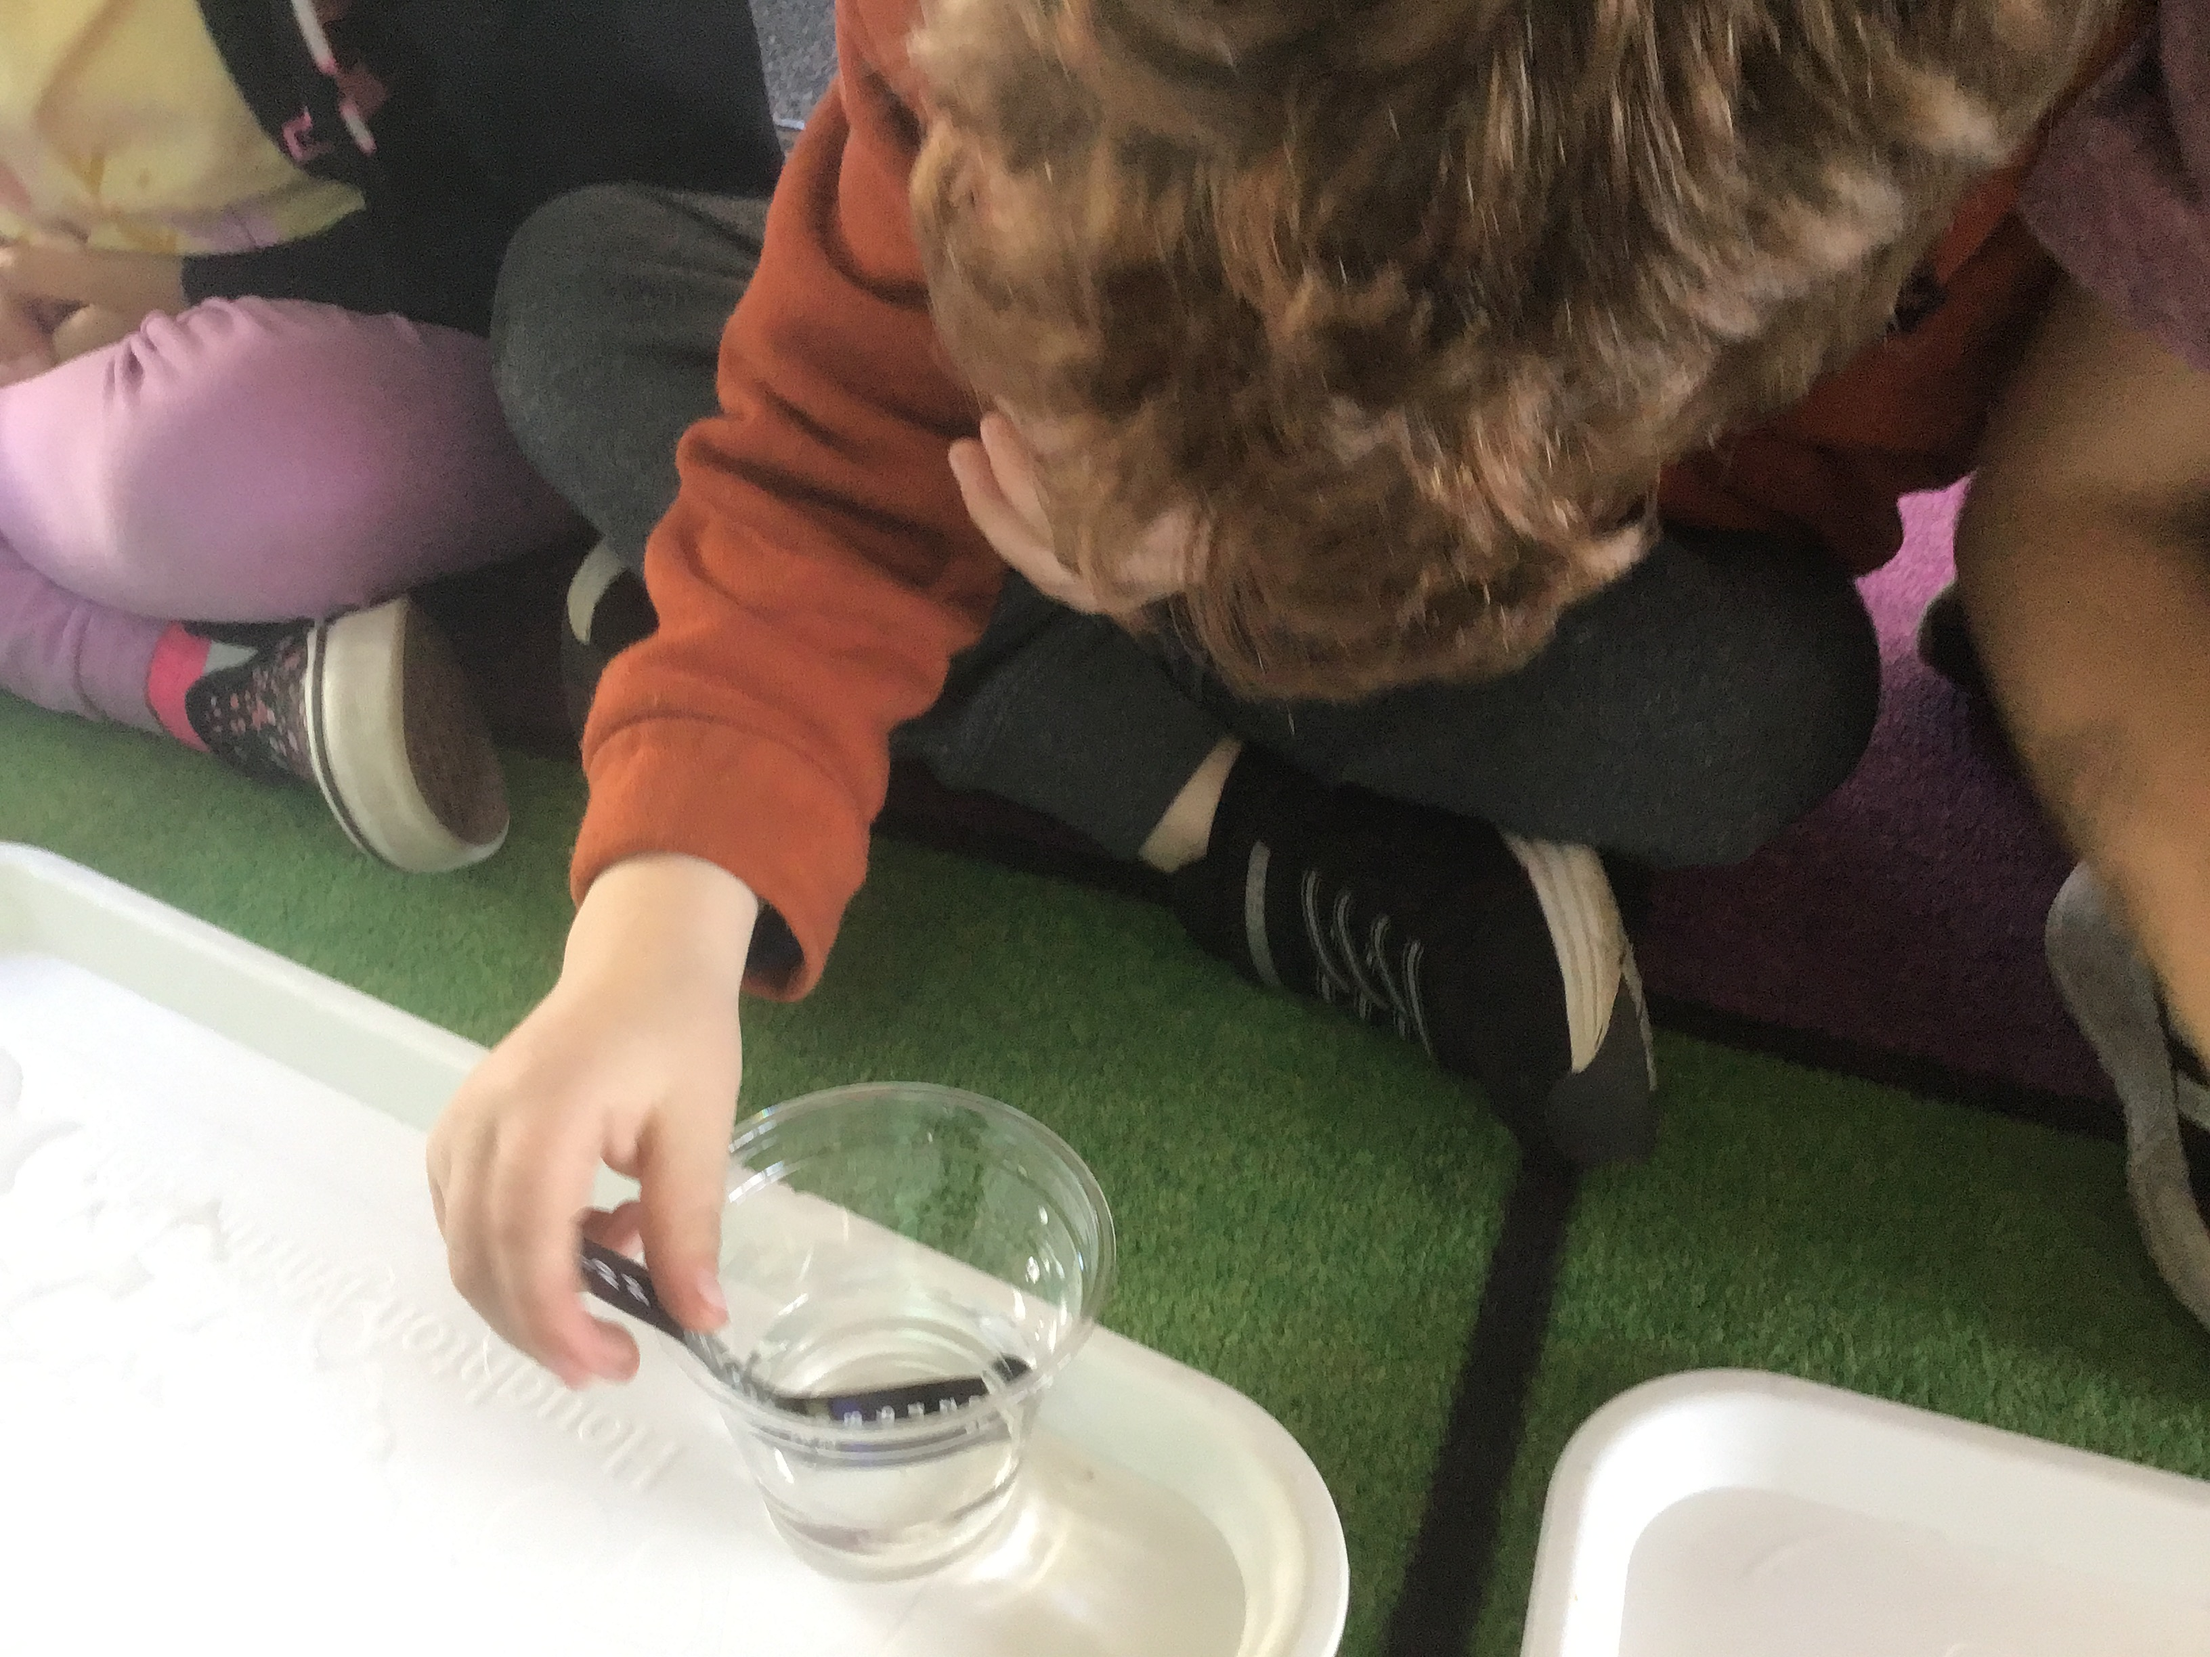
Attendance
Please minimize classroom interruptions by ensuring that your student arrives on time to school every day
Students who arrive late must obtain a late pass from the office
Report your child's absence.
(619) 258-2205
We are school #2.

Slide 9
Breakfast
Breakfast service begins at 8:00
All breakfast food must be consumed by 8:25
NO students are allowed on playgrounds prior to 8:15
Complimentary for all kiddos

Slide 10
Drop-0ff
Only students who plan on eating breakfast may be on campus beginning at 8:00 AM - they may enter through the gate near the multi-purpose room. EVERYONE ELSE SHOULD NOT ARRIVE PRIOR TO 8:15 AM
Bus riders will be dropped off and directed to breakfast or the kindergarten playground (my firsties may play on the kinder playground in the morning)
There will be supervision beginning at 8:15 AM and then students may play on the kinder playground.
I will pick up students from the playground.
School starts at 8:30 AM
Adults should drop off and leave campus asap –it makes transitions easier for the littles – thanks for understanding!

Slide 11
Pick-up
Students must be picked up by an adult or older sibling from the kindergarten gate (we will discuss daycare pick-ups as needed) – firsties may wait at the lunch table or walk to the bus or Project Safe on their own
Please stay outside the gate and I will release students asap
Bus riders may be picked up by older siblings or they will be walked to the bus by another teacher
Project Safe and all other after school providers will pick up students at our room or gate
You cannot park in a red zone or handicap area

Slide 12
Playground Guidelines
Please work with your children on:
Keeping hands and feet to themselves
No climbing or running UP the slides
Singing ABC’s slowly to take turns on the swing
Not throwing wood chips or sand
Freezing when they hear the whistle

Slide 13
Folders and Homework
Math homework will be sent home and completed on the honor system
Red folders will be sent home daily - empty out completed work and return documents that require signatures, etc. promptly to the in-box on top of the cubbies

Slide 14
Birthdays
We will celebrate with a birthday crown, a reading of the birthday book, and a birthday song
No classroom treats may be brought to school with the exception of non-compliant days
If you would like to send something special to share with the class, please consider a book donation or a small non-food gift for each child

Slide 15
Classroom Communication
It is preferable that short conversations occur before or after school and ones that are more lengthy in nature be via email, the app., or appointment.
Phone: 619-956-5100, extension 5123
Email: robin.dawson@santeesd.net
Website: www.msrdawson.weebly.com - Check weekly for class assignments, updates, and calendar information
App.: Download or open the ClassDojo app and enter your invite code to join our class. Or join our class at www.classdojo.com
Our ability and willingness to communicate openly will benefit your child’s academic and social success
Please check your child’s folder, my website, and Class DoJo Frequently

Slide 16
Student of the Week
Each week we will celebrate a student of the week!
Look for a poster and informational letter to come home on Friday
Return the poster by the following first day of the week

Slide 17
Discipline
Class DoJo points and rewards for positive behavior
Tiger Tickets
Lunch Bunch
Treasure Chest
Restorative Practices
Consequences That Are Fair and Not Punitive
Talking circle
Acknowledgement
Respect
Responsibility
Relationship-building
Relationship-repairing

Slide 18
Thank you! You are your child’s first and most important teacher.
I come to work every day not for a paycheck, but because it is my life’s work.
It is my desire for families to see the value of their experience and, together, to inspire future leaders of the world who are able to compete in a global economy and think, create, and collaborate with enthusiasm and confidence.
My door is always open.
I only ask that you receive each child in reverence, use a whisper voice within the walls of our learning community, and enter with a positive attitude.

